Slide 1


Scientific Calculator Project in Python
Sanju - Developed in Visual Studio Code

Slide 2

Project Overview
Exploring the Scientific Calculator Development
The project aims to create a user-friendly scientific calculator using Python and Tkinter, leveraging Visual Studio Code for development and GitHub for project management.

Slide 3
Key Functionalities
Overview of calculator features and capabilities
Basic Arithmetic
Scientific Functions
Constants Included
The calculator efficiently handles basic operations such as addition, subtraction, multiplication, and division, providing users with quick access to essential mathematical functions.
It includes advanced scientific operations like trigonometric functions (sin, cos, tan), logarithms, and square roots, catering to users requiring more comprehensive calculations in their tasks.
The calculator conveniently incorporates essential mathematical constants such as π (pi) and e (Euler’s number), facilitating more complex scientific calculations for users in various fields.

Slide 4
Technical Implementation
Overview of development and error handling
The calculator was developed using Python and the Tkinter framework, focusing on error handling to manage invalid inputs and enhance user experience efficiently.

Slide 5
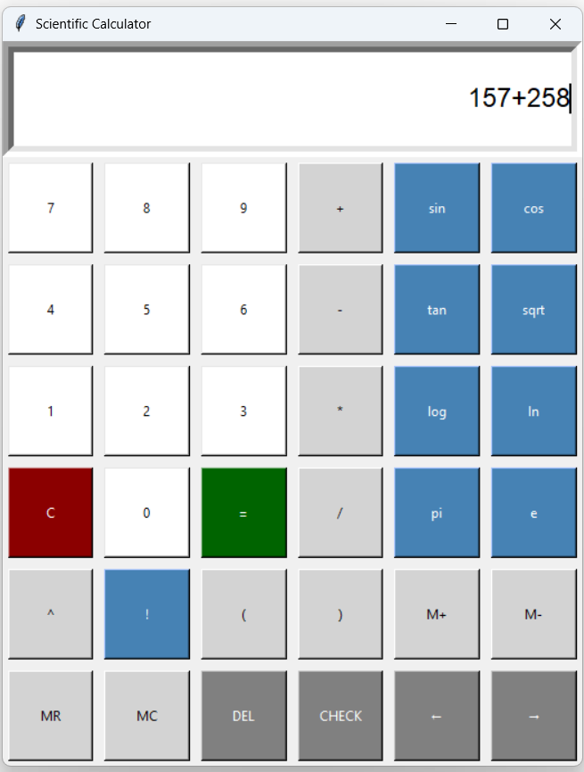
Final Output
The completed scientific calculator features a sleek design, showcasing its intuitive interface and responsive functionality, developed with Python and Tkinter.

Slide 6
Learning Outcomes
Skills Acquired Through Project Development
This project enabled the mastery of Python GUI development and enhanced understanding of event-driven programming, error handling, and collaborative workflows using GitHub for efficient project management.

Slide 7
Thank You

